Slide 1

CS 162 Midterm 1 Review
Fall 2024

Slide 2
Zoom Logistics
This presentation will be recorded, so turn your video off if you do not want to be in the recording
Use chat to answer or ask questions

Slide 3
Disclaimer
This is not an exhaustive review of all topics that are in scope for the midterm.
These are course materials that are all in scope:
Lectures 1-10
Project 0
Project 1 Design
Homework 0-2
Discussions 0-3

Slide 4
Outline
Dual-mode operation, context switching, and interrupts
Processes and Threads
File API, I/O
Locks, semaphores, condition variables, synchronization

Slide 5

Operating System
Layer of software that interfaces between (diverse) hardware resources and the (many) applications running on the machine
Referee
Illusionist
Glue
Notes:
Referee: Referee Manage protection, isolation, and sharing of resources
Illusionist: Provide clean, easy-to-use abstractions of physical resources
Glue: Provides a set of common services

Slide 6
Dual Mode Operation
Kernel
User
Process Management
File System Management
Memory Management
Device Management
System Calls
Security and Protection
User-level applications
Standard user-level code within restricted virtual address spaces
Most shell commands

Slide 7
What hardware support is necessary to enable protection?
Privileged Instructions
Unsafe instructions cannot be executed in user mode
Memory Isolation:
Memory accesses outside a process’s address space prohibited
Interrupts:
Ensure kernel can regain control from running process
Safe Transfers:
Correctly transfer control from user-mode to kernel mode and back

Slide 8
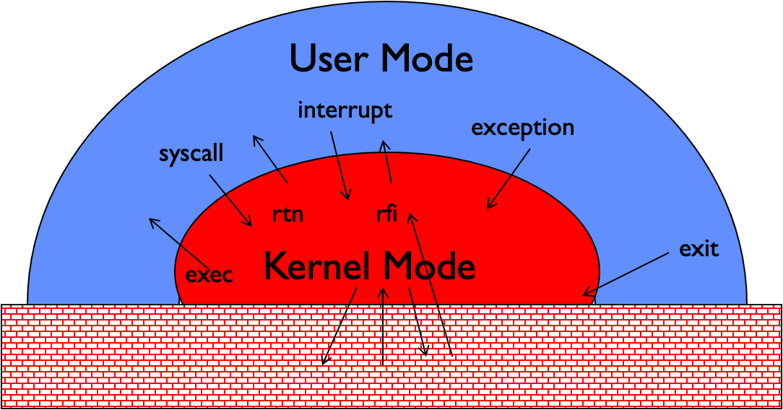
How do you switch from kernel mode to user mode and back?
Syscalls - used by processes to request certain services (e.g. exec, read, write)
Hardware Interrupts - external asynchronous events (e.g. timer, I/O)
Traps - software interrupts or exceptions, internal synchronous events (e.g. exceptions)

Slide 9
Interrupt Handling Roadmap
Processor detects interrupt
Suspend user program and switch to kernel stack
Identify interrupt type and invoke appropriate interrupt handler
Restore user program
Roadmap is nearly identical for syscalls and exceptions!!

Slide 10
Processes
Instances of a running program
Process Control Block (PCB) in OS that stores necessary metadata such as process state, PID, open files list, memory limits, PTBR (1 page table per process), etc.
An executing program with restricted rights
OS is in charge of:
Giving every process the illusion of running on a private CPU
Giving every process the illusion of running on private memory
Managing resources to allocate to each process
Isolating processes from all other processes and protect OS

Slide 11
Process Management API
exit – terminate a process 💀
fork – copy the current process 👤 → 👤
exec – change the program being run by the current process
wait – wait for a process to finish 😴
kill – send a signal (interrupt-like notification) to another process
sigaction – set handlers for signals
Not an exhaustive list, but some of the more common ones

Slide 12
fork()
Creates a new child process, a copy of the original parent process
Allocate a new PCB for the new process with duplicated memory context
Makes complete copy of process state:
Address Space, Code/Data Segments, Registers, Stack, Open Files, Pointers to Files/IO
Uses copy-on-write to make duplication more efficient
Allocates new PID and saves the same EIP as the parent process
OS can schedule either child or parent process
To distinguish, returns 0 for child and > 0 for parent

Slide 13
fork() ex.
int void main() { int data = 3; int success = fork(); if (success == -1) { return 1; } else if (success == 0) { // Execute child logic } else { int child_pid = success; // pid > 0 // Execute parent logic } return 0; }

Slide 14
exec()
Call to Unix exec() replaces running program!
exec() System Call handler will:
Replace the code and data segment
Set EIP to point to start of new program/reinitialize SP and FP
Push arguments to program onto stack.
Notes:
Error made in recording: exec does not use copy-on-write!

Slide 15
sigaction()
Signal: very short message that may be sent to a process or a group of processes. (ex. SIGKILL, SIGTSTOP, SIGCONT, … see HW 2)
Each process has unique ID (pid) and a shared group id (pgid)
Used to make process aware that specific event has occurred
Allow process to execute a signal handler function when event has occurred
Each signal has a default action
Can use sigaction() to override default action with signal handler
When signal is caught, program jumps to signal handler function
Control of the program resumes at the previously interrupted instructions

Slide 16
Unix I/O and Files
Uniformity
Same set of system calls open, read, write, close
Explicit Open Before Use, Close After Use
Must explicitly open file/device/channel
Must explicitly close resource (or memory is leaked)
Kernel Buffered Reads/Writes
Data is buffered in kernel to decouple internals from application

Slide 17
File Descriptors
Integer >= 0 that uniquely identifies an open IO resource in the OS
Used to index into a per-process file descriptor table
Each FD points to an open file description in a global table of open file descriptions
Each file description in the table contains:
File offset
File access mode (from open())
File status flags (from open())
ORD_ONLY, OWR_ONLY, O_RDWR (see man open)
Reference to physical location
Number of times opened
Can duplicate an FD to have multiple FDs point to the same file (dup)
Open file description remains alive until no file descriptors refer to it
dup2 - can replace an already-existing fd

Slide 18
Pipes
int pipe(int pipedfd[2])
One-way communication between two processes on the same physical machine
Read-only end (pipedfd[0]) and write-only end (pipedfd[1])
Limited buffer space - Blocks if write is called on a full pipe. Blocks if read is called on empty pipe.
After last “write” descriptor is closed, pipe is effectively closed and reads return only “EOF”

Slide 19
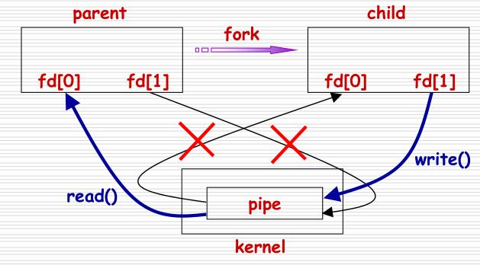
int fds[2]; pipe(fds); // Validation checking omitted for brevity if (fork() != 0) { close(fds[1]); // Parent is read-only read(fds[0], outbuf, n); // Parent reads from pipe to outbuf } else { close(fds[0]); // Child is write-only write(fds[1], inbuf, n); // Child writes inbuf to pipe }

Slide 20
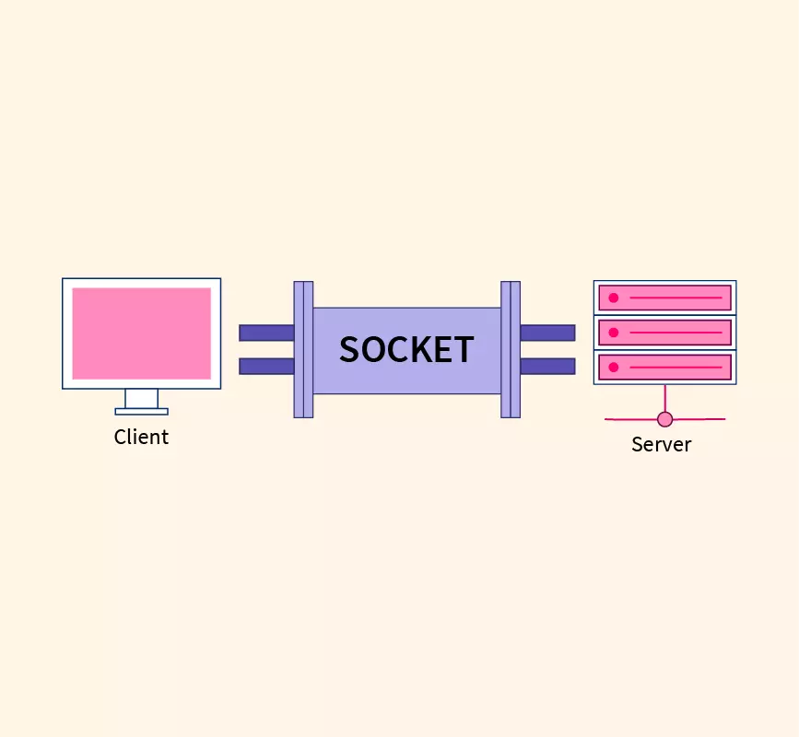
Sockets
Abstraction of two queues, one in each direction
Can read or write to either end
Used for communication between multiple processes on different machines
File descriptors obtained via socket/bind/connect/listen/accept
Still a file and uses same API/data structures as files and pipes

Slide 21
From FDs to FILEs
Instead of using integer file descriptors to describe files and relying on low-level I/O syscalls, high-level I/O API use “FILE” structures from the OS library
FILE* is an OS Library wrapper for manipulating only files, not pipes, sockets, etc.
This FILE structure contains:
File descriptor (from call to open)
Buffer (array)
Lock (in case multiple threads use the FILE concurrently)
FILE* API operates on streams – unformatted sequences of bytes (text or binary data), with a position
int fd = open(...); vs FILE* fptr = fopen(...);

Slide 22
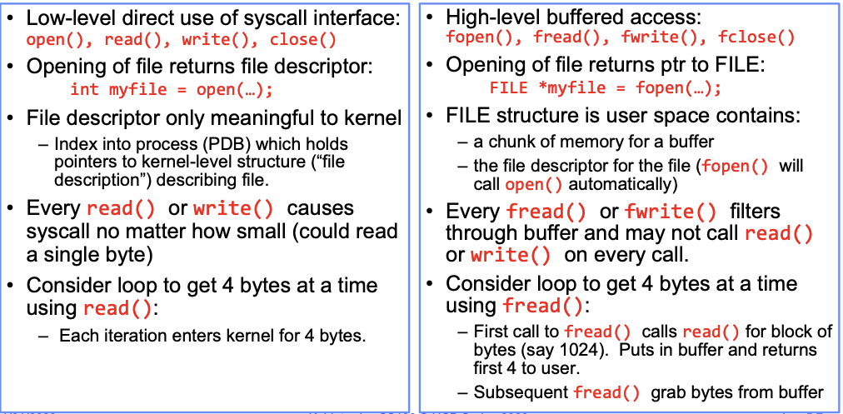
Low-Level I/O API
High-Level I/O API

Slide 23
FD API vs FILE* API
FILE* is Buffered IO:
Maintains a per-file user-level buffer.
Write calls write to buffer.
System flushes buffer to disk when full (or on special character)
Read calls read from buffer. System reads from disk when buffer empty
FD API is Immediate I/O:
Operations on file descriptors are unbuffered & visible immediately
Biggest contrast is FD I/O immediately performs I/O whereas FILE* operates on kernel buffer first
FILE* API calls don’t have to go to disk as much as FD API!
Kernel just reads fixed size block from disk & buffer into user-space

Slide 24
Threads
A thread is a single execution sequence that represents a separately schedulable task
Threads are really useful for:
Natural Program Structure:
Simultaneously update screen, fetch new data from network, receive keyboard input
Exploiting parallelism:
Split unit of work into n tasks and process tasks in parallel on multiple cores.
Responsiveness:
High priority work should not be delayed by low priority work. Schedule as separate threads for independence
Masking IO latency:
Continue to do useful work on separate thread while blocked on IO

Slide 25
Thread Qualities
No protection:
Threads inside the same process and are not isolated from each other
Share an address space
Share IO state (FDs)
Individual execution:
Threads execute disjoint instruction streams.
Need own execution context
Given individual stack and register state (including EIP, ESP, EBP)

Slide 26
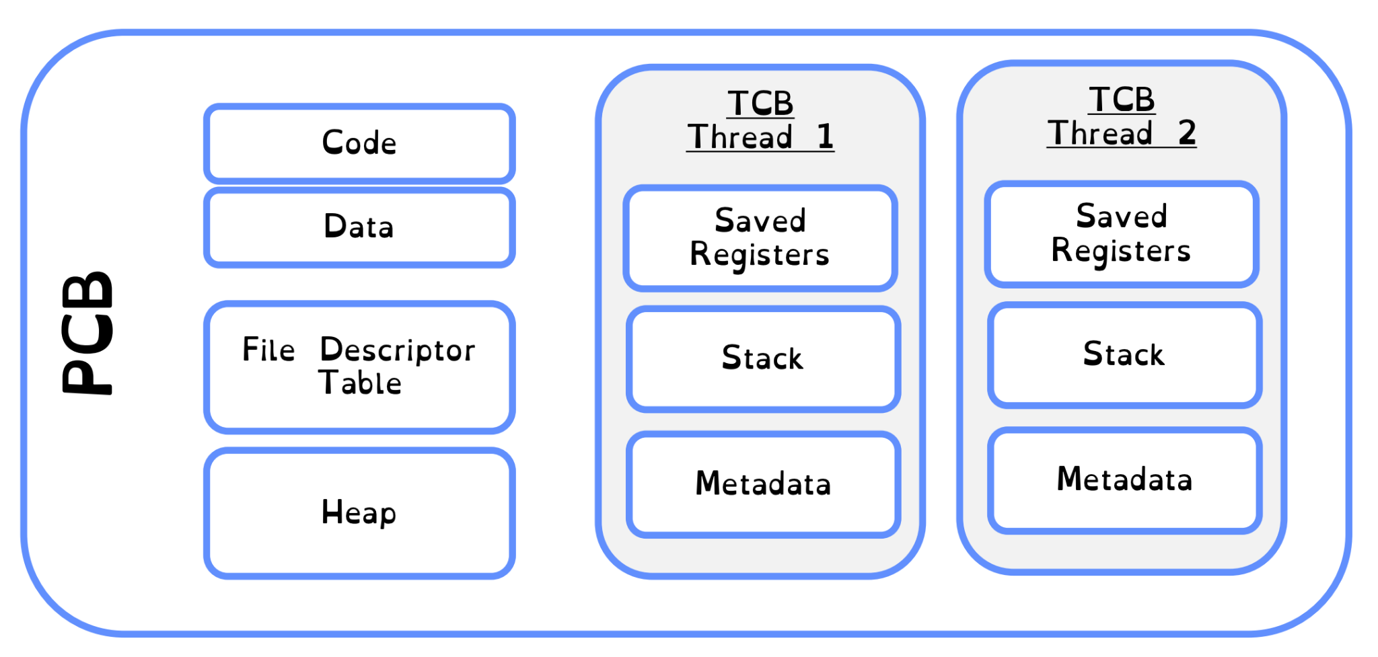
Threads vs Processes Visual
Processes are like the containers in which threads execute

Slide 27
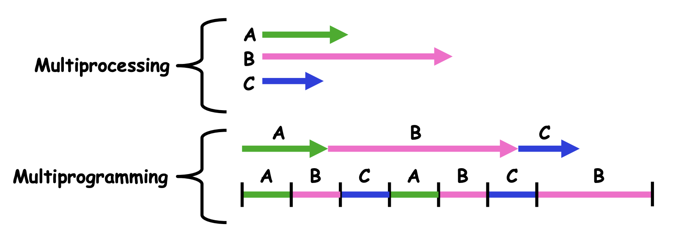
Multi-Everything
Multiprocessing ≡ Multiple CPUs
Multiprogramming ≡ Multiple Jobs or Processes
Multithreading ≡ Multiple Threads per Process
Multiple threads running “concurrently” can be scheduled in any order the OS wants
But threads can end up racing for shared data in the process

Slide 28
Stacks for processes
void main() { int data = 0; int x = 1; pid_t pid = fork(); if (pid != 0) { data = 1; printf("data is %d, &x is %x\n", data, &x); waitpid(pid, NULL, 0); } else { data = 2; printf("data is %d, &x is %x\n", data, &x); exit(0); } }
What does this code print?
// Assume &x = DEADBEEF

Slide 29
Stacks for processes (soln.)
void main() { int data = 0; int x = 1; pid_t pid = fork(); if (pid != 0) { data = 1; printf("data is %d, &x is %x\n", data, &x); waitpid(pid, NULL, 0); } else { data = 2; printf("data is %d, &x is %x\n", data, &x); exit(0); } }
data is 1, &x is DEADBEEF
data is 2, &x is DEADBEEF
(either order is possible)

Slide 30
Stacks for Threads
void helper (void * arg) {
int *data = (int *) arg; *data = 1; printf("*data is %d, data is %x\n", *data, data); pthread_exit(0); }
void main() { pthread_t thread; int data = 0; printf("data is %d, &data is %x\n", data, &data); pthread_create(thread, NULL, &helper, &data); pthread_join(thread, NULL); printf("data is %d, &data is %x\n", data, &data); }
What does this program print? Assume &data = 0xDEADBEEF.
Notes:
Threads also have separate stacks, but they’re accessible. The child thread is using the same data. It’s confusing because they named the pointer data as well.

Slide 31
Stacks for threads (soln.)
void helper (void * arg) {
int *data = (int *) arg; *data = 1; printf("*data is %d, data is %x\n", *data, data); pthread_exit(0); }
void main() { pthread_t thread; int data = 0; printf("data is %d, &data is %x\n", data, &data); pthread_create(thread, NULL, &helper, &data); pthread_join(thread, NULL); printf("data is %d, &data is %x\n", data, &data); }
data is 0, &data is 0xDEADBEEF (main)
*data is 1, data is 0xDEADBEEF (helper)
data is 1, &data is 0xDEADBEEF (main)
Notes:
Threads also have separate stacks, but they’re accessible. The child thread is using the same data. It’s confusing because they named the pointer data as well.

Slide 32
Heaps for processes
void main() { char *x = malloc(100); strcpy(x, "temporary"); pid_t pid = fork(); if (pid != 0) { strcpy(x, "hello1"); printf("%s address of x is %x\n", x, &x); waitpid(pid, NULL, 0); } else { strcpy(x, "hello2"); printf("%s address of x is %x\n", x, &x); exit(0); } }
What does this program print? Assume &x = 0xDEADBEEF.
Notes:
fork() makes a copy of the address space. The child has x in its heap, at the same address. But when it changes the value of x, that change isn’t reflected in the parent process.

Slide 33
Heaps for processes (soln.)
void main() { char *x = malloc(100); strcpy(x, "temporary"); pid_t pid = fork(); if (pid != 0) { strcpy(x, "hello1"); printf("%s address of x is %x\n", x, &x); waitpid(pid, NULL, 0); } else { strcpy(x, "hello2"); printf("%s address of x is %x\n", x, &x); exit(0); } }
hello2 address of x is 0xDEADBEEF
hello1 address of x is 0xDEADBEEF
(either order is possible)
Notes:
fork() makes a copy of the address space. The child has x in its heap, at the same address. But when it changes the value of x, that change isn’t reflected in the parent process.

Slide 34
Heap for threads
void helper(void * arg) {
char *x = (char *) arg; // on the stack
strcpy(x, "hello2");
printf("%s address of x is %d\n", x, &x);
}
void main() {
pthread_t thread;
char *x = malloc(100); // on the heap
strcpy(x, "hello1");
printf("%s address of x is %d\n", x, &x);
pthread_create(&thread, NULL, &helper, x);
pthread_join(thread, NULL);
printf("%s address of x is %d\n", x, &x);
}
What does this program print?
Assume &x = 0xDEADBEEF.
Notes:
The address here is not the address of the malloc’d memory in heap (if we printed out that, then all the addresses would be the same). We are printing out the address of x, which is on the stack. The address for x on the main thread stack is different than the address for x on the helper thread stack.

Slide 35
Heap for threads (soln.)
void helper(void * arg) {
char *x = (char *) arg; // on the stack
strcpy(x, "hello2");
printf("%s address of x is %d\n", x, &x);
}
void main() {
pthread_t thread;
char *x = malloc(100); // on the heap
strcpy(x, "hello1");
printf("%s address of x is %d\n", x, &x);
pthread_create(&thread, NULL, &helper, x);
pthread_join(thread, NULL);
printf("%s address of x is %d\n", x, &x);
}
hello1 address of x is 0xDEADBEEF (main)
hello2 address of x is 0xDEADBEEF (helper)
hello2 address of x is 0xDEADBEEF (main)
Notes:
The address here is not the address of the malloc’d memory in heap (if we printed out that, then all the addresses would be the same). We are printing out the address of x, which is on the stack. The address for x on the main thread stack is different than the address for x on the helper thread stack.

Slide 36
File descriptors for processes
int fd; void main() { fd = open("output", O_CREAT|O_WRONLY); pid_t pid = fork(); if (pid != 0) {
waitpid(pid, NULL, 0); printf("close fd %d returns %d\n", fd, close(fd)); } else { printf("close fd %d returns %d\n", fd, close(fd)); exit(0); } }
What does this program print? Assume fd == 3 after open() and close(fd) returns a close status (0 for success, -1 otherwise).

Slide 37
File descriptors for processes (soln.)
int fd; void main() { fd = open("output", O_CREAT|O_WRONLY); pid_t pid = fork(); if (pid != 0) {
waitpid(pid, NULL, 0); printf("close fd %d returns %d\n", fd, close(fd)); } else { printf("close fd %d returns %d\n", fd, close(fd)); exit(0); } }
close fd 3 returns 0 (child closes its copy first)
close fd 3 returns 0 (parent then closes its fd)
Child process gets copies of parent’s fd’s! File isn’t closed until all fd’s for it are closed!

Slide 38
File descriptors for threads
int fd;
void *helper (void *arg) { printf("close fd %d returns %d\n", fd, close(fd)); pthread_exit(0); } void main() { fd = open("output", O_CREAT|O_TRUNC|O_WRONLY); pthread_t thread; pthread_create(&thread, NULL, &helper, NULL); pthread_join(thread, NULL); printf("close fd %d returns %d\n", fd, close(fd)); }
What does this program print? Assume fd == 3 after open() and close(fd) returns a close status (0 for success, -1 otherwise).
Notes:
Threads share file descriptors, so the second close is invalid

Slide 39
File descriptors for threads (soln.)
int fd;
void *helper (void *arg) { printf("close fd %d returns %d\n", fd, close(fd)); pthread_exit(0); } void main() { fd = open("output", O_CREAT|O_TRUNC|O_WRONLY); pthread_t thread; pthread_create(&thread, NULL, &helper, NULL); pthread_join(thread, NULL); printf("close fd %d returns %d\n", fd, close(fd)); }
close fd 3 returns 0 (child closes fd first)
close fd 3 returns -1 (parent can’t close it anymore)
Child threads share the same address space and don’t copy the parent thread’s fd’s!
Notes:
Threads share file descriptors, so the second close is invalid

Slide 40
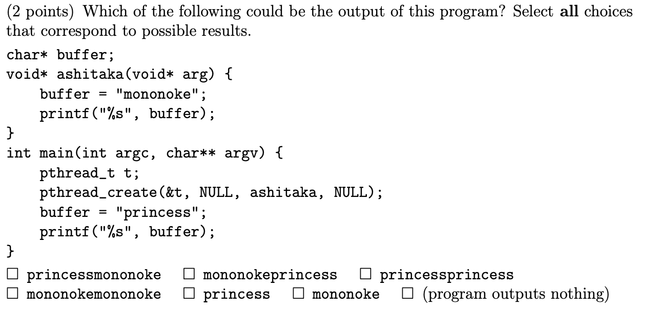
Non-determinism

Slide 41
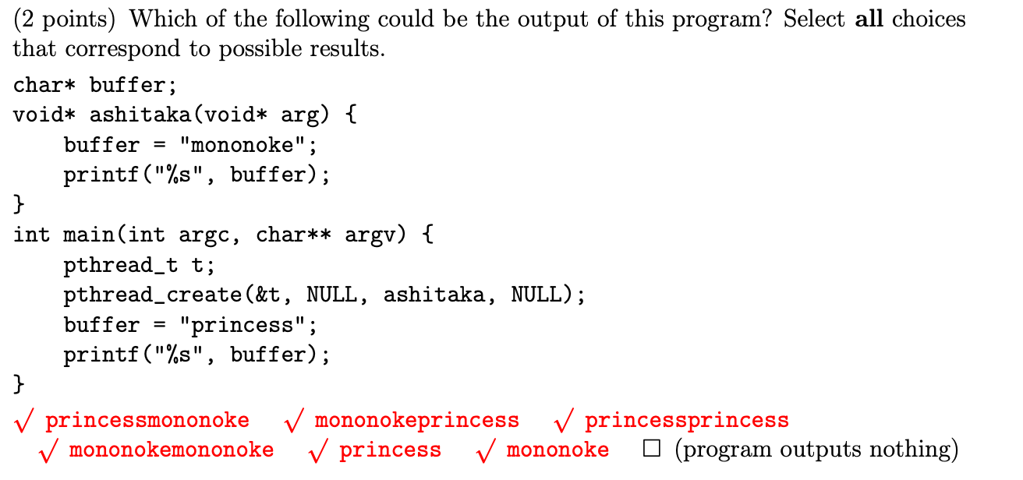
Non-determinism (soln.)
Notes:
Princessprincess is because buffer can be overwritten, princess is because main thread can exit early

Slide 42
Non-determinism (soln.)
princessmononoke
The main thread sets buffer = “princess” and prints, then child thread sets buffer = “mononoke” and prints.
mononokeprincess
The child thread sets buffer = “mononoke” and prints, then the main thread sets buffer = “princess” and prints.
princessprincess
The child thread first sets buffer = “mononoke”. Then, the main thread sets buffer = “princess”. Then both threads print.
mononokemononoke
The main thread first sets buffer = “princess”. Then, the child thread sets buffer = “mononoke”. Then both threads print.
princess
The main thread sets buffer = “princess” and prints, and exits without giving the child thread the chance to execute.
mononoke
The main thread sets buffer = “princess”. The child thread then sets buffer = “mononoke”. The main thread then prints and exits without giving the child a chance to continue.

Slide 43
For Your Cheatsheet
Comparison Categ. | Across Processes | Across Threads
Creation | fork() | pthread_create()
Page table | Distinct | Same
Registers, instruction pointer | Distinct | Distinct
Stack | Separate and inaccessible | Separate, but accessible
Heap and static variables | Separate | Shared
File descriptors | Separate | Shared
Synchronization | wait(), waitpid() | pthread_join(), semaphores, locks
Overhead | Higher | Lower
Protection | Higher | Lower

Slide 44
Concurrency Terminology
Atomic Operation: An operation that always runs to completion or not at all
On most machines, memory references and assignments (i.e. loads and stores) of words are atomic
Synchronization:
Using atomic operations to ensure cooperation between threads
Mutual Exclusion:
Ensuring that only one thread does a particular thing at a time
Critical Section:
Piece of code that only one thread can execute at once

Slide 45
Solution to Race Conditions
Need to protect “critical sections”
Lock() before entering critical section and before accessing shared data
Unlock() when leaving, after accessing shared data
Wait if locked
Important idea: All synchronization involves waiting
A few of ways to “lock” or synchronize a critical section:
Busy Wait (just rely on atomic loads and stores)
Use synchronization primitives that disable/enable interrupts (powerful, but could be dangerous if not done correctly)

Slide 46
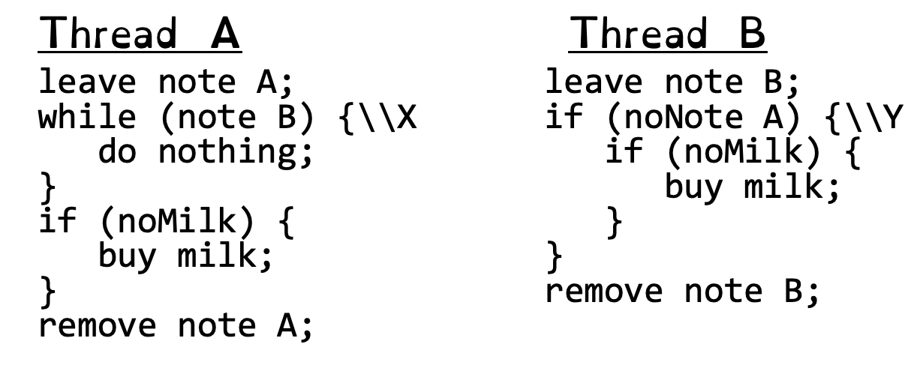
Busy Wait
While thread B is operating the refrigerator, thread A will continue to execute its while loop and consume CPU cycles until OS switches back to thread B – very inefficient! Don’t do this on an exam!
Atomic loads and stores work, but bad on the CPU

Slide 47
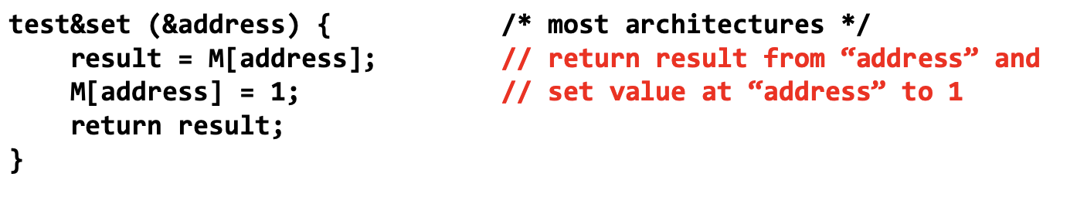
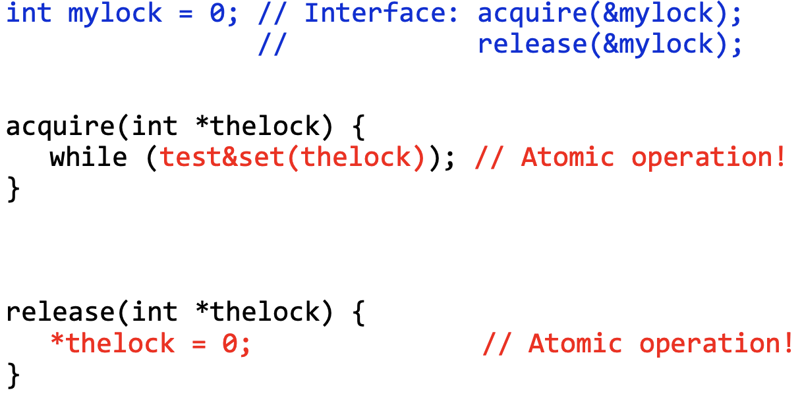
test&set() Lock Implementation
Atomic Operations
Notes:
Pros: Machine receives interrupts, User can use this lock
Cons: Thread inefficient, priority inversion (higher priority will take away cycles from other threads → no progress)

Slide 48
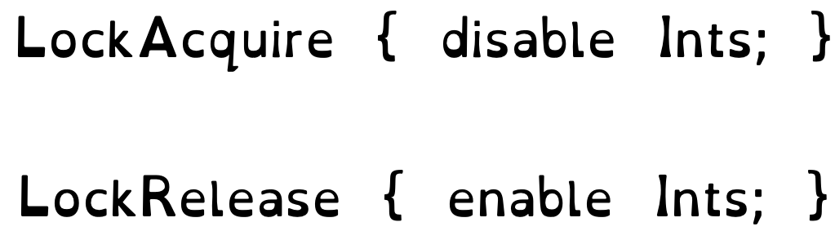
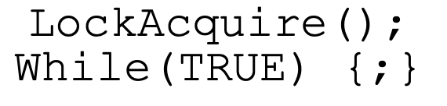
Disable & Enable Interrupts
You need to be really careful disabling interrupts
What if you do this… 😨

Slide 49
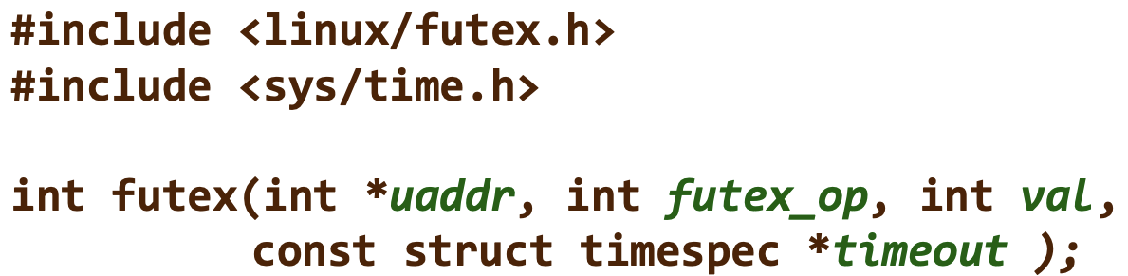
Futex Solution
uaddr points to a 32-bit value in user space
futex_op
FUTEX_WAIT:
if (val == *uaddr) → go to sleep until we hear a FUTEX_WAKE operation
Atomic check that condition still holds after we disable interrupts
FUTEX_WAKE:
Operation that wakes up at most val waiting threads

Slide 50

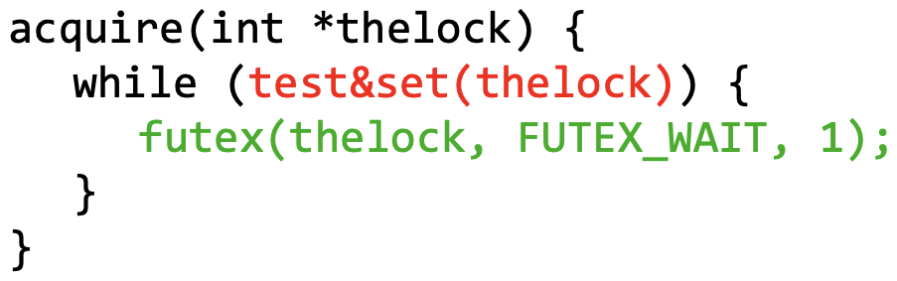
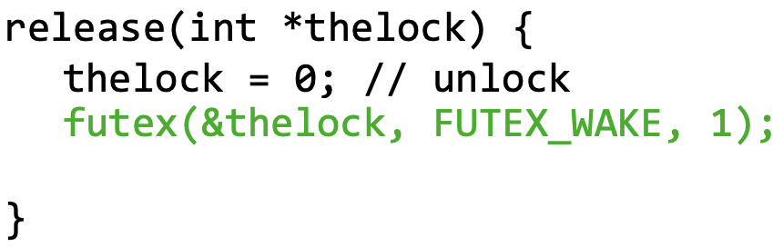
Futex Applied
Just put thread to sleep
No more busy waiting!
Wakes up val sleeping
threads, even if there is none

Slide 51
Semaphores
Semaphores are like locks, but rely on the state of a non-negative integer value instead of a boolean/binary state
When you initialize a semaphore, you initialize it with some non-negative integer value
Semaphore will put a thread to sleep when it tries down() on a semaphore value of 0
Multi-Purpose:
Mutual Exclusion (value is 0 or 1, essentially imitating a lock)
Scheduling Constraints (value can be >= 0, used to schedule threads based on the constraints of your program, think of player/server problem from discussion!)

Slide 52
Semaphore Operations
sema_init (semaphore* sema, value) {
Initialize semaphore value to
requested non-negative value;
}
sema_down (semaphore* sema) {
Disable interrupts;
While (semaphore value == 0) {
Go to sleep and
schedule another thread;
}
Decrement semaphore value by 1;
Enable interrupts;
}
sema_up (semaphore* sema) {
Disable interrupts;
Wake up a sleeping thread;
Increment semaphore value by 1;
Enable interrupts;
}
typedef struct semaphore {
unsigned value;
struct list waiters;
} semaphore;
When a thread gets put to sleep, the OS will re-enable interrupts as it schedules another thread to run!

Slide 53
Locks
Locks can also be quite neatly implemented using internal semaphores
We would initialize the lock’s semaphore to 1 and keep track of who acquires the lock
Call sema_down() within lock_acquire() and sema_up() within lock_release()
In this way, the lock’s semaphore value will only alternate between 0 and 1
Purpose: used so that threads can access/modify shared data synchronously

Slide 54
Lock Operations
typedef struct lock {
struct thread* holder;
struct semaphore* sema;
} lock;
lock_init (lock* lock) {
Initialize the holder of this
lock to NULL;
sema_init(&lock->sema, 1);
}
lock_acquire (lock* lock) {
sema_down(&lock->sema);
Set the holder of this lock
to caller;
}
lock_release (lock* lock) {
Reset lock holder back to NULL;
sema_up(&lock->sema);
}
The internal semaphore operations are atomic, shown in the previous slide! Therefore, the actual acquisition of the lock relies on the state of the internal semaphore.

Slide 55
Lock Operations (Spin-Locking)
typedef struct lock {
struct thread* holder;
int value;
} lock;
lock_init (lock* lock) {
Initialize the holder of this
lock to NULL;
lock->value = 0;
}
lock_acquire (lock* lock) {
while (test&set(&lock->value) == 1){
// Busy waiting
}
Set the holder of this lock
to caller;
}
lock_release (lock* lock) {
Reset lock holder back to NULL;
lock->value = 0;
}
test&set (void* address) {
int result = *address;
*address = 1;
return result;
}

Slide 56
Conditional Variables
A queue of threads waiting for something inside a critical section
In contrast to semaphores, conditional variables can allow sleeping inside the critical section by atomically releasing lock at time we go to sleep
Require a lock to be held when performing certain conditional variable operations
Purpose: used so that threads can access/modify shared data when a certain condition is met
Monitor: a lock and zero or more condition variables for managing concurrent access to shared data

Slide 57
Conditional Variable Operations
typedef struct cond_var {
struct list waiters;
} cond_var;
cond_init (cond_var* cond) {
Initialize cond’s list
of waiters;
}
cond_wait (cond_var* cond, lock* lock) {
Create a semaphore for this waiter;
sema_init(&waiter_sema, 0);
Push this waiter’s semaphore
into the waiters queue;
lock_release(lock);
sema_down(&waiter_sema);
lock_acquire(lock);
}
Must have acquired the lock before you perform cond_wait()! Notice that we release the lock first in order to allow other threads to finish and then reacquire when we’ve woken up.

Slide 58
Cond Signaling / Broadcasting To Waiters
cond_signal (cond_var* cond) {
if (waiters queue is not empty) {
Pop a waiter off and execute
sema_up() on their semaphore;
}
}
cond_broadcast (cond_var* cond) {
while (waiters queue is not empty) {
Pop a waiter off and execute
sema_up() on their semaphore;
}
}
cond_signal() will wake up only 1 waiting thread whereas cond_broadcast() will wake up all waiting threads!
cond_broadcast() can therefore be made up of several calls to cond_signal().
Must acquire the lock before these operations and release afterwards appropriately in order ensure safe access to the shared data as threads get scheduled!

Slide 59
Mesa vs Hoare Semantics
How can we actually use conditional variables in practice?
How do we know when to sleep or signal and how should we check our required conditions?
Mesa and Hoare semantics offer two ways to implement a monitor
Let’s assume our example from lecture and discussion:
Consider an infinite synchronized buffer problem of vending machines where there’s a producer and consumer. “Infinite” refers to the fact that the machine has no limit on how much coke it can hold.
struct lock buffer_lock;
struct cond_var buffer_cond;
struct list coke_machine;
// Assume we initialized all of these structures

Slide 60
Hoare Semantic
void producer(struct coke* coke) {
lock_acquire(&buffer_lock);
Insert coke into coke_machine;
cond_signal(&buffer_cond);
lock_release(&buffer_lock);
}
struct coke* consumer() {
lock_acquire(&buffer_lock);
if (list_empty(&coke_machine))
cond_wait(&buffer_cond, &buffer_lock);
Pop a coke from the coke_machine;
lock_release(&buffer_lock);
return coke;
}
Only does one check on the coke_machine’s status. Once the thread is awaken, it can proceed with the lock if it’s available and try to take a coke out of the coke_machine.
But are you absolutely sure the coke_machine still has coke by the time the thread tries to pop one? 🤔

Slide 61
Hoare Semantic
When a waiting thread gets woken up, it’s not guaranteed that it will be scheduled by the OS at a time that satisfies our condition
Example Scenario (Assume coke_machine initially empty and some initial thread creates Thread A and Thread B):
Thread A runs consumer() and sleeps because the coke_machine is empty
Thread B runs producer(), puts 1 coke in the empty coke_machine, and wakes up Thread A
Before Thread A tries to re-acquire the buffer_lock, thread C gets created and runs consumer() to completion, emptying out the coke_machine
Our poor thread A will then be scheduled next only to find that it’s trying to pop coke out of an empty coke_machine 😢
For Hoare’s semantic to be reliable for our system, it really depends on the OS scheduler

Slide 62
Mesa Semantic
void producer(struct coke* coke) {
lock_acquire(&buffer_lock);
Insert coke into coke_machine;
cond_signal(&buffer_cond);
lock_release(&buffer_lock);
}
struct coke* consumer() {
lock_acquire(&buffer_lock);
while (list_empty(&coke_machine))
cond_wait(&buffer_cond, &buffer_lock);
Pop a coke from the coke_machine;
lock_release(&buffer_lock);
return coke;
}
In contrast to Hoare, this semantic will repeatedly check our coke_machine status to make sure that we definitely have coke available when we have the lock and try to pop a coke.
This semantic is much easier and safer to implement!

Slide 63
Old Bridge Problem
An old bridge has only one lane and can only hold at most 3 cars at a time without risking collapse. Traffic goes both ways.
Fill in the functions ArriveBridge(int direction) and ExitBridge() so that at any given time, there are at most 3 cars on the bridge, and all of them are going the same direction.
A car calls ArriveBridge()when it arrives at the bridge and wants to go in the specified direction (0 for left or 1 for right); ArriveBridge() should not return until the car is allowed to get on the bridge.
A car calls ExitBridge() when it gets off the bridge, and allows other cars to get on.
Whenever the bridge is not empty or full and a car is waiting to go the same direction as the cars on the bridge, that car should get on the bridge.
One direction of cars gets to flush out completely before the other direction is allowed. Don’t worry about starvation/fairness.

Slide 64


Example Picture of Scenario

Slide 65
Starvation Explanation
In this case, all the waiting cars on the left will be allowed to cross the bridge before we allow the waiting car on the right to cross

Slide 66
Old Bridge Problem Details
We will be using the following data structures:
struct cond_var cond_directions[2];
Array of 2 conditional variables that represent a waiting queue for each direction
struct lock cond_lock;
A lock that you may use to synchronize access to necessary data
int waiters[2];
Array of 2 integers that track how many cars are waiting to travel in either direction
int cars_on_bridge = 0;
Number of cars currently on the bridge
int curr_direction = 0;
Direction of the cars that are currently on the bridge (default is 0)
Assume we’ve initialized the conditional variables in cond_directions and filled waiters with 0s for each direction

Slide 67
ArriveBridge() - Skeleton
// Remember, you can use struct cond_var cond_directions[2], int waiters[2],
// struct lock cond_lock, int curr_direction, int cars_on_bridge
int ArriveBridge(int direction) {
____________________________________
while (cars_on_bridge == 3 ||
(cars_on_bridge > 0 && curr_direction != direction)) {
_________________________________
_________________________________
_________________________________
}
____________________________________
____________________________________
____________________________________
}

Slide 68
ArriveBridge() - Soln.
// Remember, you can use struct cond_var cond_directions[2], int waiters[2],
// struct lock cond_lock, int curr_direction, int cars_on_bridge
int ArriveBridge(int direction) {
____________________________________
while (cars_on_bridge == 3 ||
(cars_on_bridge > 0 && curr_direction != direction)) {
waiters[direction]++;
cond_wait(&cond_directions[direction], &cond_lock);
waiters[direction]--;
}
____________________________________
____________________________________
____________________________________
}

Slide 69
ArriveBridge() - Soln.
// Remember, you can use struct cond_var cond_directions[2], int waiters[2],
// struct lock cond_lock, int curr_direction, int cars_on_bridge
int ArriveBridge(int direction) {
____________________________________
while (cars_on_bridge == 3 ||
(cars_on_bridge > 0 && curr_direction != direction)) {
waiters[direction]++;
cond_wait(&cond_directions[direction], &cond_lock);
waiters[direction]--;
}
cars_on_bridge++;
curr_direction = direction;
____________________________________
}

Slide 70
ArriveBridge() - Soln.
// Remember, you can use struct cond_var cond_directions[2], int waiters[2],
// struct lock cond_lock, int curr_direction, int cars_on_bridge
int ArriveBridge(int direction) {
lock_acquire(&cond_lock);
while (cars_on_bridge == 3 ||
(cars_on_bridge > 0 && curr_direction != direction)) {
waiters[direction]++;
cond_wait(&cond_directions[direction], &cond_lock);
waiters[direction]--;
}
cars_on_bridge++;
curr_direction = direction;
lock_release(&cond_lock);
}

Slide 71
ExitBridge() - Skeleton
// Remember, you can use struct cond_var cond_directions[2], int waiters[2],
// struct lock cond_lock, int curr_direction, int cars_on_bridge
int ExitBridge() {
________________________________
________________________________
If (waiters[curr_direction] > 0) {
________________________________
} else if (cars_on_bridge == 0) {
________________________________
}
________________________________
}

Slide 72
ExitBridge() - Soln.
// Remember, you can use struct cond_var cond_directions[2], int waiters[2],
// struct lock cond_lock, int curr_direction, int cars_on_bridge
int ExitBridge() {
________________________________
________________________________
If (waiters[curr_direction] > 0) {
cond_signal(&cond_directions[curr_direction]);
} else if (cars_on_bridge == 0) {
cond_broadcast(&cond_directions[1 - curr_direction]);
}
________________________________
}

Slide 73
ExitBridge() - Soln.
// Remember, you can use struct cond_var cond_directions[2], int waiters[2],
// struct lock cond_lock, int curr_direction, int cars_on_bridge
int ExitBridge() {
________________________________
cars_on_bridge -= 1;
If (waiters[curr_direction] > 0) {
cond_signal(&cond_directions[curr_direction]);
} else if (cars_on_bridge == 0) {
cond_broadcast(&cond_directions[1 - curr_direction]);
}
________________________________
}

Slide 74
ExitBridge() Soln.
// Remember, you can use struct cond_var cond_directions[2], int waiters[2],
// struct lock cond_lock, int curr_direction, int cars_on_bridge
int ExitBridge() {
lock_acquire(&cond_lock);
cars_on_bridge -= 1;
If (waiters[curr_direction] > 0) {
cond_signal(&cond_directions[curr_direction]);
} else if (cars_on_bridge == 0) {
cond_broadcast(&cond_directions[1 - curr_direction]);
}
lock_release(&cond_lock);
}

Slide 75
Thank you!

